Slide 1
State-Machine Qualia and its effects on Context-Free Language Reachability
Henri Malahieude
University of Colorado Boulder
In-Class
12/09/2025

Slide 2
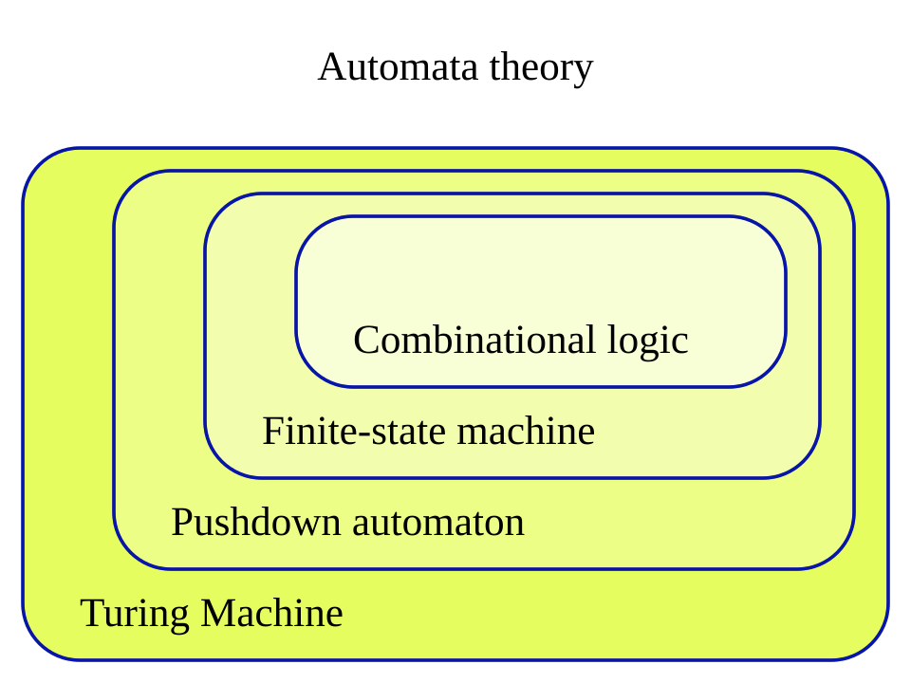
Notes:
What can the Solver’s Automata Type tell us about the analysis question of interest, in context of CFLR?

Slide 3
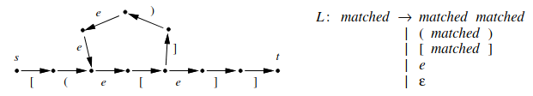
Context-Free Language Reachability
[1]
Notes:
Explain the only reachable path from S to T is through the loop.
Explain the 6 types: All-Pairs, Single-Source, Single-Target, Source-Target, Multi-Source, Multi-Target

Slide 4
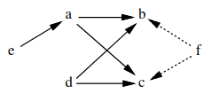
Points-To Analysis w/o Automata
a = &b;
d = &c;
d = a;
e = &a;
*e = d;
f = *e;
No Language Needed
Trivial Regex
O(e)
[1]
Notes:
Hesitate to label this a contribution

Slide 5
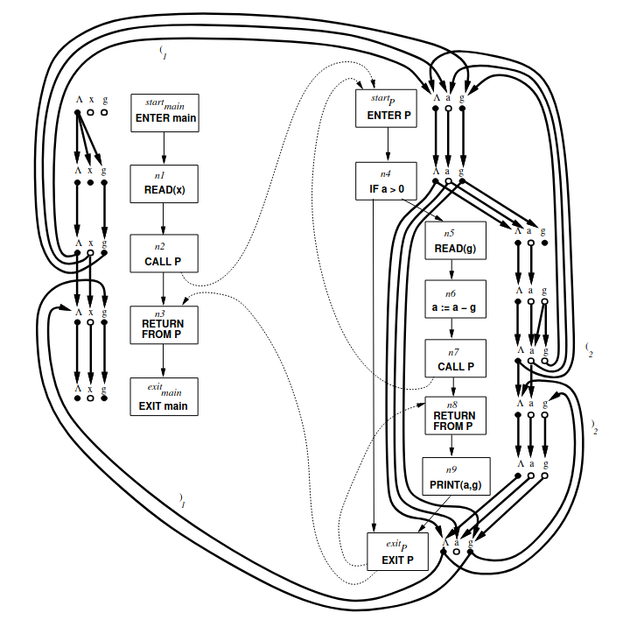
Complex Inter-Procedural Analysis
[1]
Notes:
Structure & Language contributes
0. Possibly Uninitialized Analysis. CFL based on Dyck, therefore needs PDA
1. Inter-procedural Program Slicing
2. Shape Analysis
But what about questions that don’t fit the 6 ways?

Slide 6
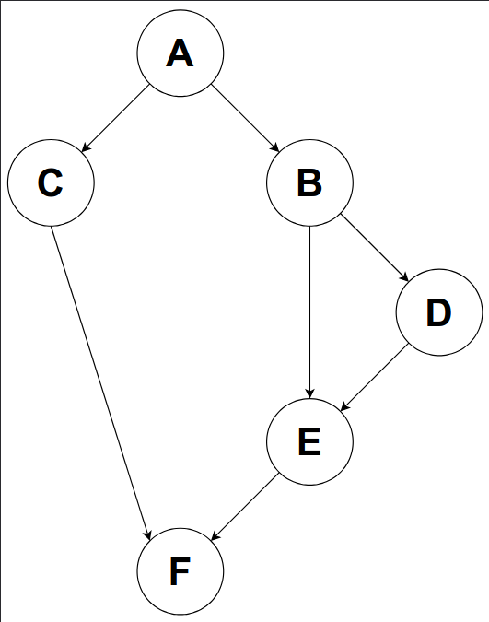
What about Dominance?
Uninitialized(cur) = (ⵡ_{j ∊pred}Uninitialized(j)) - Initialized(cur)
Dominates(cur) = (⊓_{j ∊pred}Dominates(j)) ⵡ {cur}
Contribution 1:
Notes:
The basis of almost all other analyses. Missing from all papers I read. Its control-flow analysis, but still

Slide 7
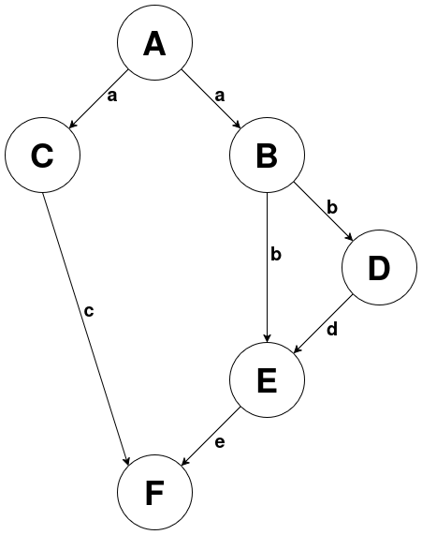
Single-Source All-Paths Intersection
L = a(b(d?e?)|c)?
S₀ := a S₁
S₁ := b S₂ | 𝛆
S₁ := c | 𝛆
S₂ := d S₃ | 𝛆
S₂ := e | 𝛆
S₃ := e | 𝛆
Contribution 1:
Notes:
Missing types of CFLR
Not yet dominance, need intersection for it

Slide 8
Single-Source All-Paths Intersection
L = a(b(d?e?)|c)?
Dominance = L_{o} ⊓ L₁ ⊓ … ⊓ L_{n}
Paths (A -> F):
a, c
a, b, e
a, b, d, e
Paths (A -> E):
a, b
a, b, d
Contribution 1:
Notes:
Missing types of CFLR
Not yet dominance, need intersection (define it too) for it

Slide 9
Algorithm Analysis
[Regex] O(w) : w = |string|
[Dominance] O(e * log₂(v)) : e = edges, v = #vertices
[General Bottleneck] O(n³)
Contribution 2:
Notes:
Power of Intuition and Reasoning for Big-O (and no need for a stack like other)
Original Paper mentions O(n^3) bottleneck

Slide 10
Future Work
Regex & Finite State-Machines
  Simple Points-To Analysis
Regex Intersection:
  Dominance
Pushdown Automata:
  Interprocedural Analysis
Visibly Pushdown Automata [2]
Recursive State-Machines [3]
Notes:
No memory needed
Little memory required
Stack Required

Slide 11
Thank you
Questions?
References
Program Analysis via Graph Reachability,
Thomas Reps, LP 1997
Visibly Pushdown Languages,
Alur et al., STOC 2004
Analysis of Recursive State-Machines,
Alur et al., TOPLAS 2005

